Slide 1
Applications and Deep Learning State of the Art

Slide 2
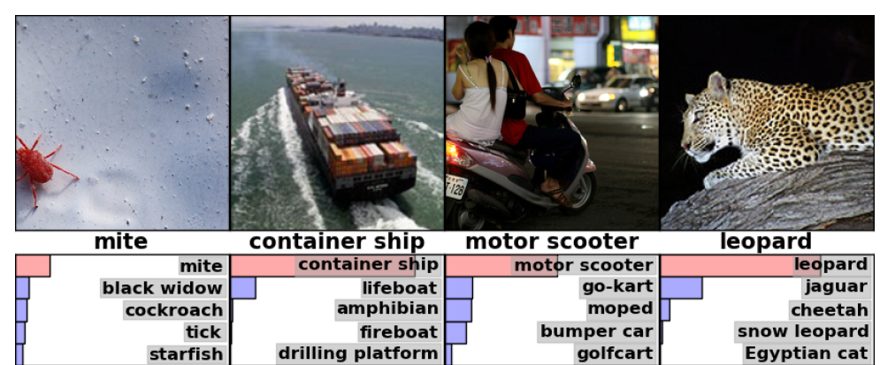
Image Recognition
Imagenet is the standard benchmark set for image recognition
Classify 256x256 images into 1000 categories, such as ”person”, ”bike”, ”cheetah”, etc.
Total 1.2M images
Many error metrics, including top-5 error: error rate with 5 guesses
Picture from Alex Krizhevsky et al., ”ImageNet Classiﬁcation
with Deep Convolutional Neural Networks”, 2012

Slide 3
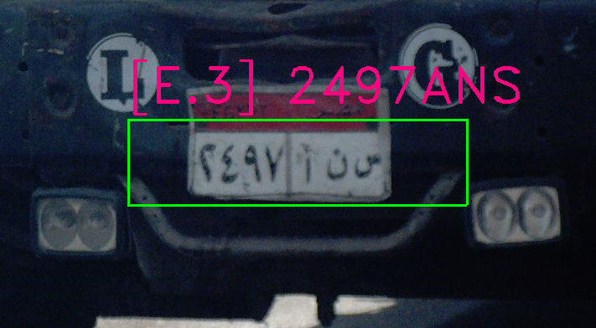
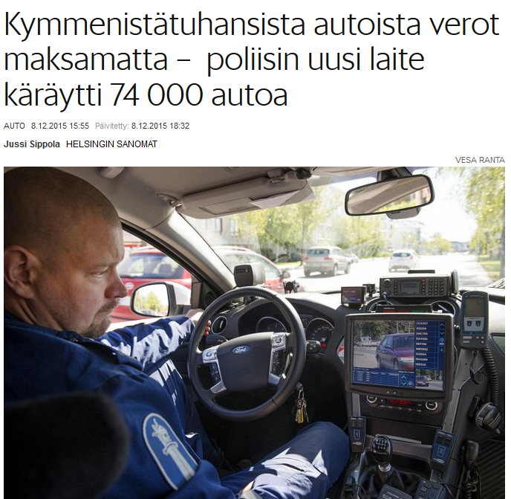
Computer Vision: Case Visy Oy
Computer vision for logistics since 1994
License plates (LPR), container codes,…
How to grow in an environment with heavy competition?
Be agile
Be innovative
Be credible
Be customer oriented
Be technologically state-of-the-art

Slide 4
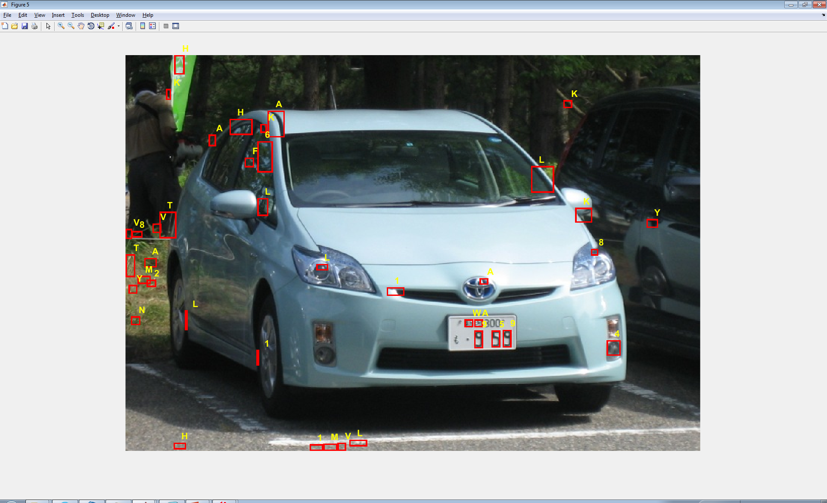
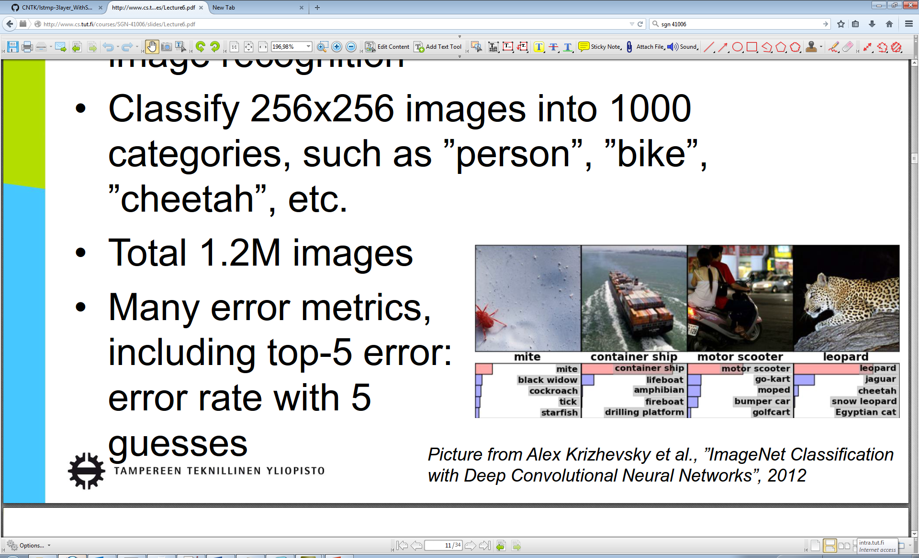
What has changes in 20 years?
In 1996:
Small images (e.g., 10x10)
Few classes (< 100)
Small network (< 4 layers)
Small data (< 50K images)
In 2016:
Large images (256x256)
Many classes (> 1K)
Deep net (> 100 kerrosta)
Large data (> 1M)

Slide 5
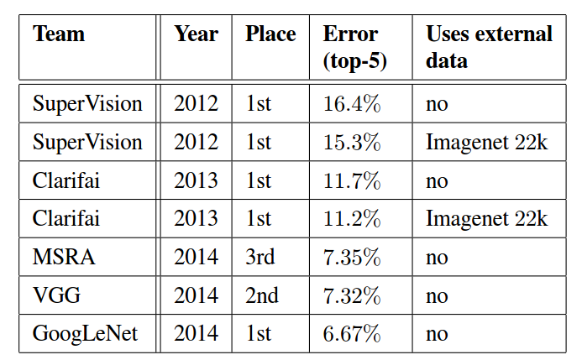
Net Depth Evolution Since 2012
ILSVRC Image Recognition Task:
1.2 million images
1 000 categories
(Prior to 2012: 25.7 %)
2015 winner: MSRA (error 3.57%)
2016 winner: Trimps-Soushen (2.99 %)
8 layers
16 layers
22 layers
152 layers
(> 1200 layers tested)

Slide 6
ILSVRC2012
ILSVRC2012¹ was a game changer
ConvNets dropped the top-5 error 26.2% → 15.3 %.
The network is now called AlexNet named after the first author (see previous slide).
Network contains 8 layers (5 convolutional followed by 3 dense); altogether 60M parameters.

Slide 7
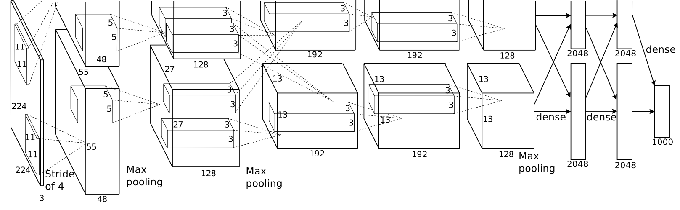
The AlexNet
The architecture is illustrated in the figure.
The pipeline is divided to two paths (upper & lower) to fit to 3GB of GPU memory available at the time (running on 2 GPU’s)
Introduced many tricks for data augmentation
Left-right flip
Crop subimages (224x224)
Picture from Alex Krizhevsky et al., ”ImageNet Classiﬁcation
with Deep Convolutional Neural Networks”, 2012

Slide 8
ILSVRC2014
Since 2012, ConvNets have dominated
2014 there were 2 almost equal teams:
GoogLeNet Team with 6.66% Top-5 error
VGG Team with 7.33% Top-5 error
In some subchallenges VGG was the winner
GoogLeNet: 22 layers, only 7M parameters due to fully convolutional structure and clever inception architecture
VGG: 16 layers, 144M parameters

Slide 9
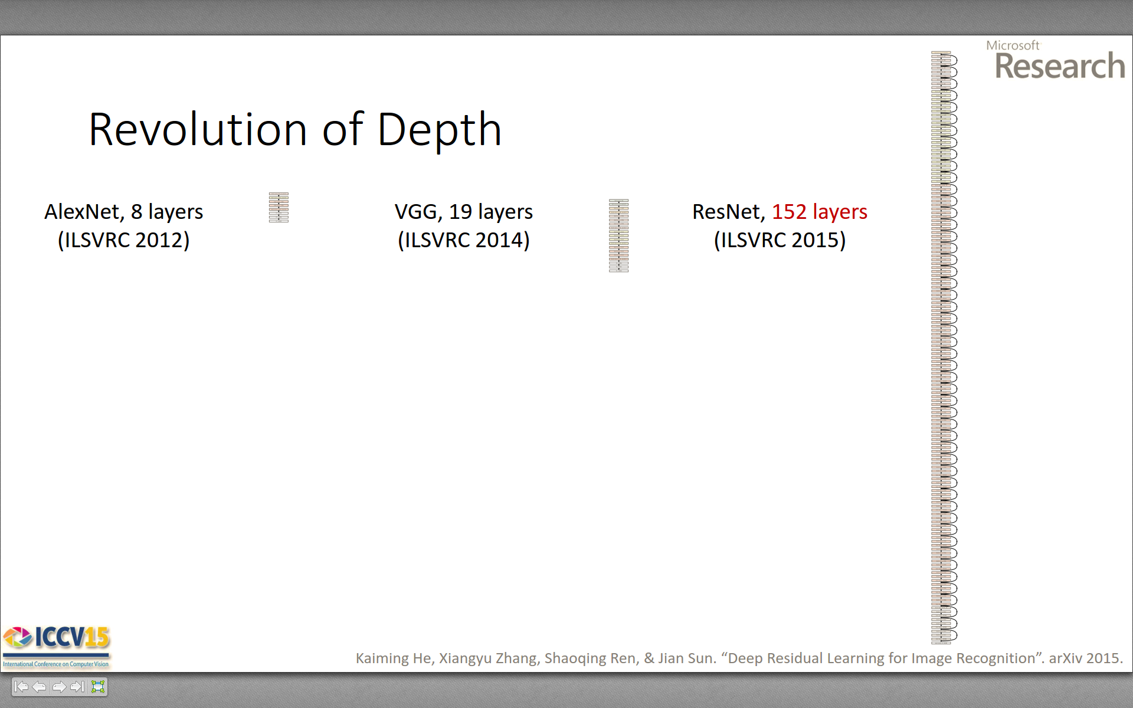
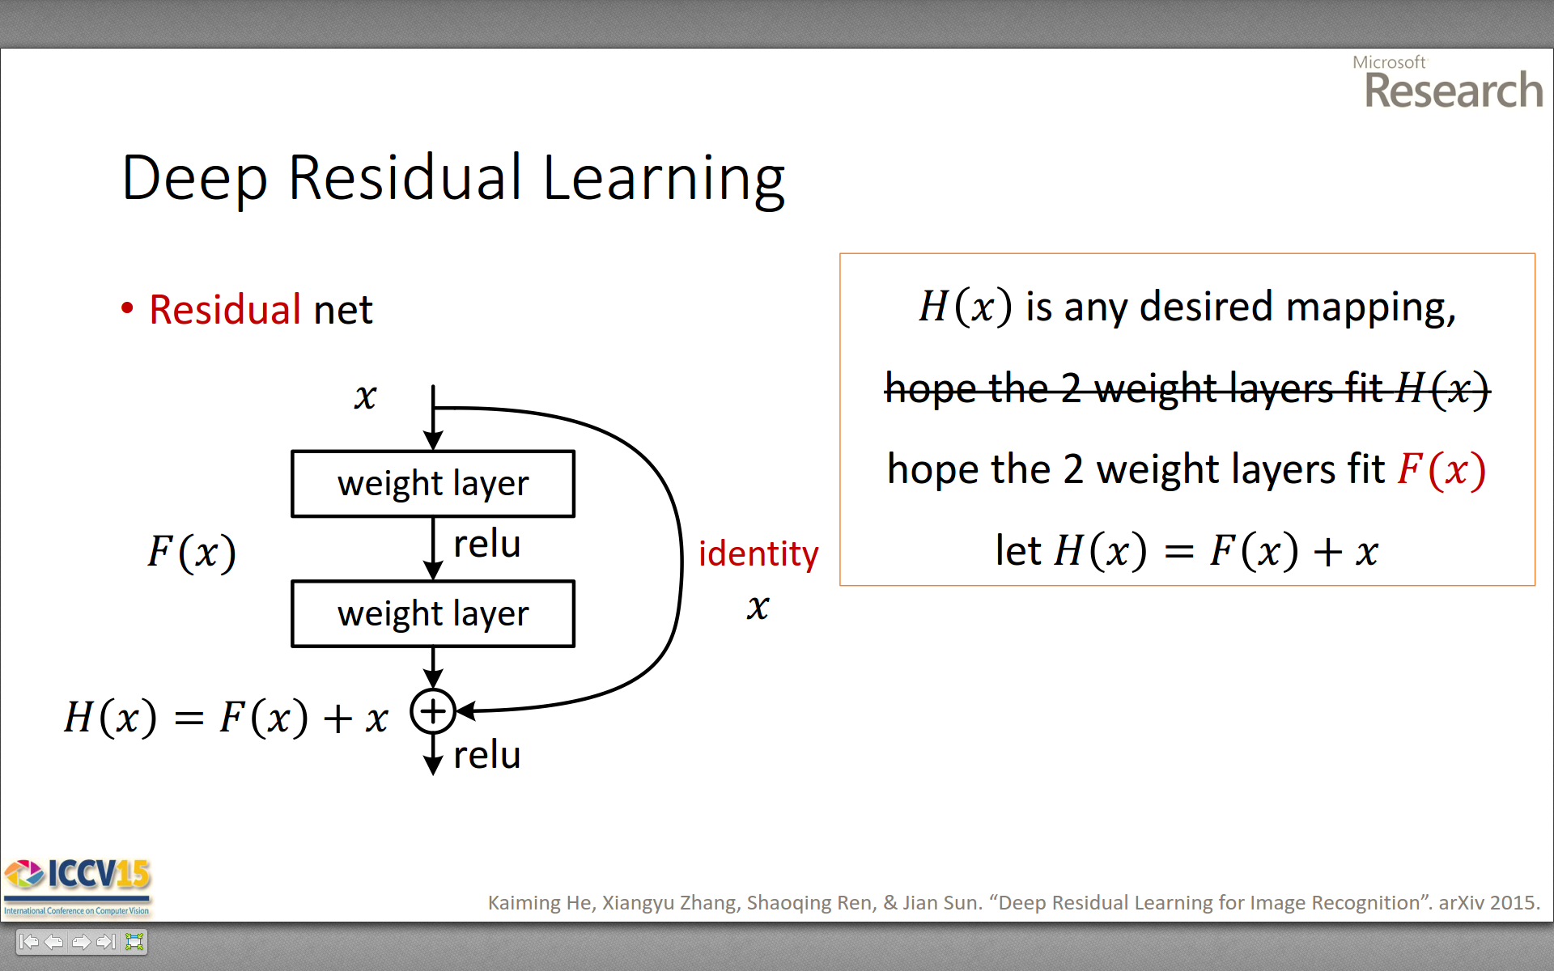
ILSVRC2015
Winner MSRA (Microsoft Research) with TOP-5 error 3.57 %
152 layers! 51M parameters.
Built from residual blocks (which include the inception trick from previous year)
Key idea is to add identity shortcuts, which make training easier
Pictures from MSRA ICCV2015 slides

Slide 10
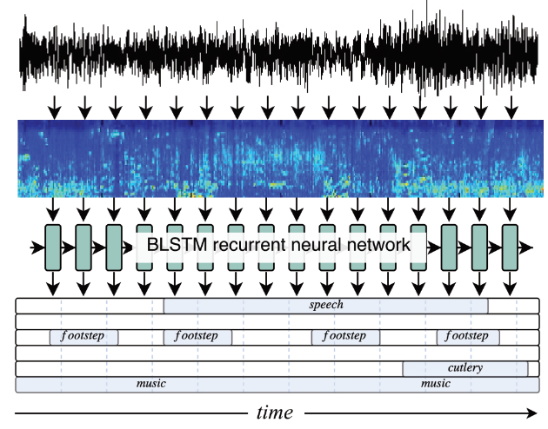
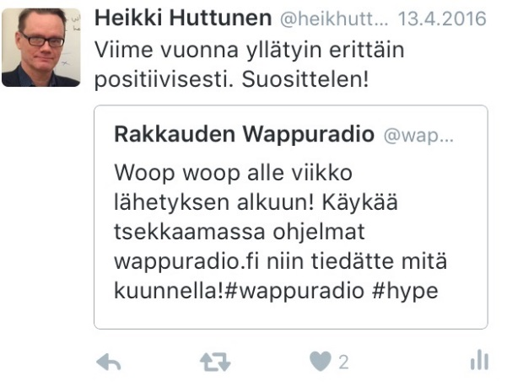
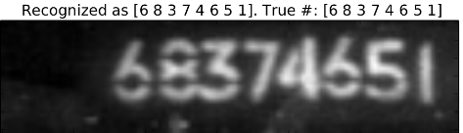
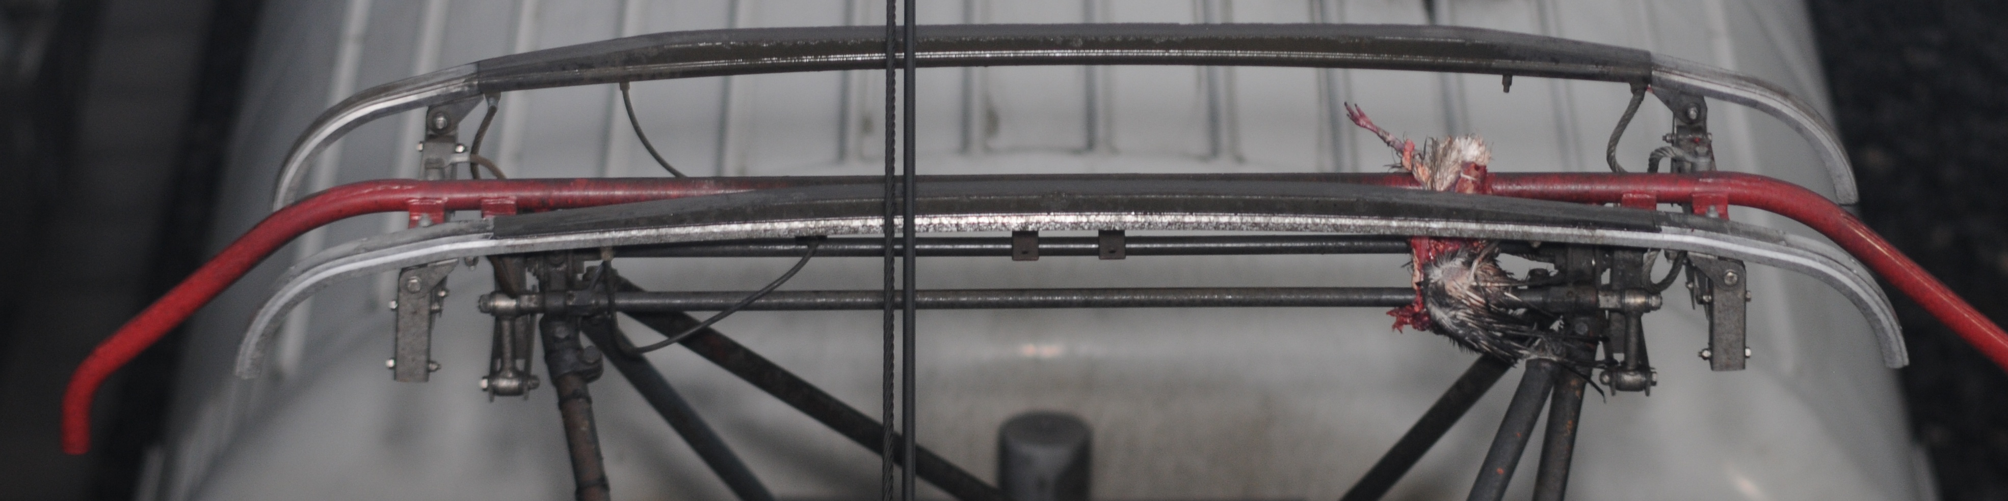
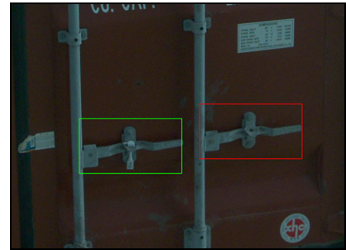
Research at TUT
Images Sound Text
Neural Net
Positive Negative Neutral

Slide 11
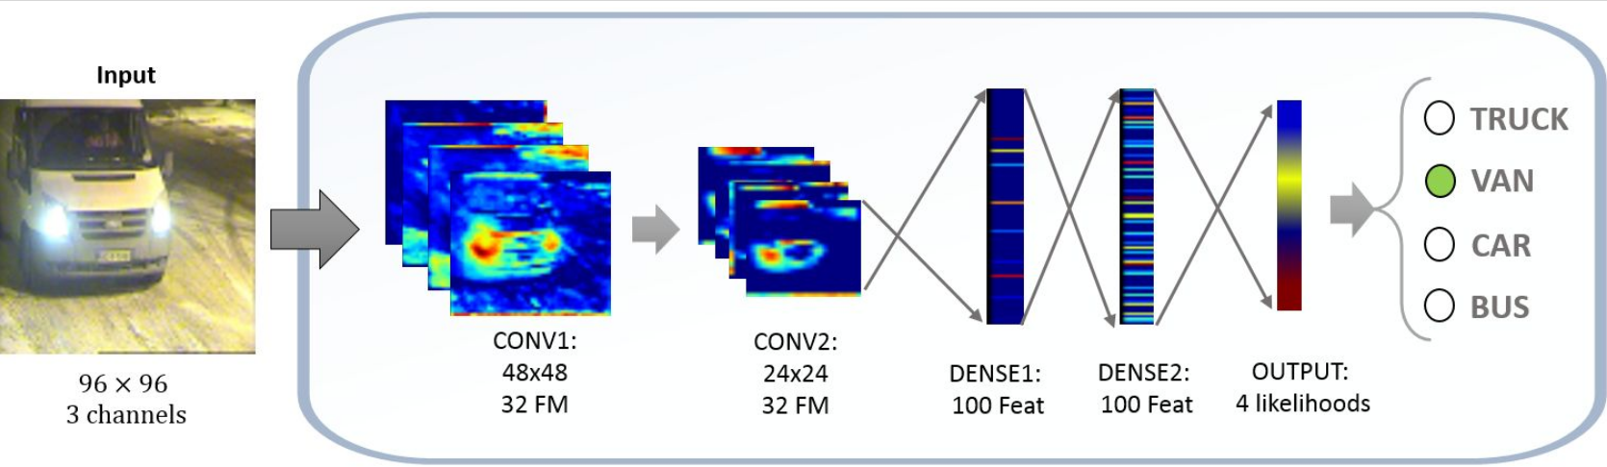
Example case
TUT has studied shallow convolutional architectures for fast/real time detection tasks
For example, Automatic Car Type Detection from Picture: Van, Bus, Truck or Normal Vehicle
The network recognizes the car type (4 classes) with 98% accuracy (13 000 images).

Slide 12
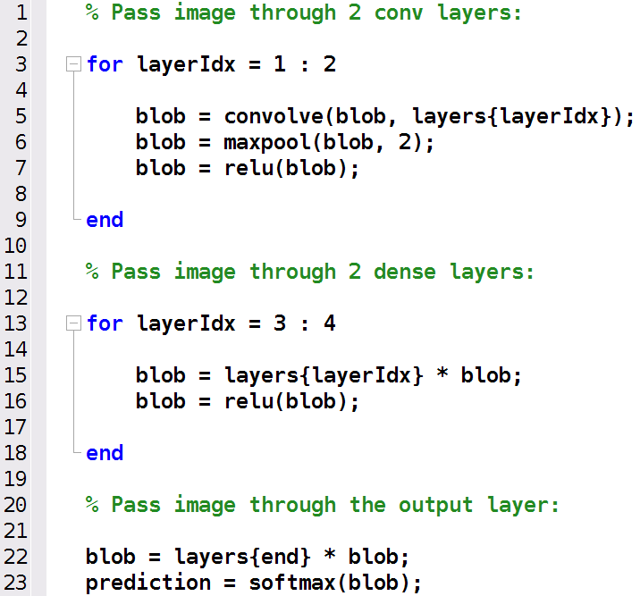
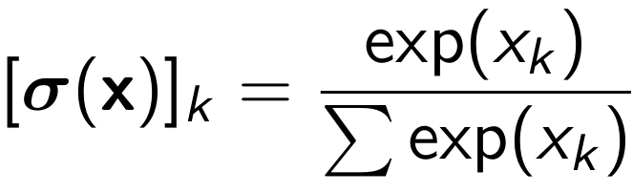
Components of the Network
Convolution: 5x5 window
Maxpooling: 2x2 downsampling with the maximum
Relu: max(x, 0)
Matrix multiplication
Softmax:

Slide 13
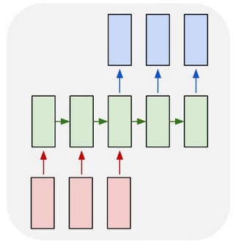
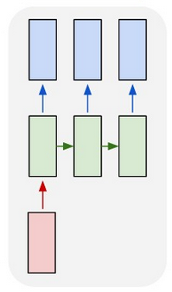
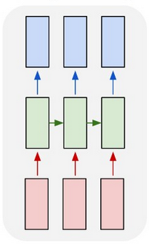
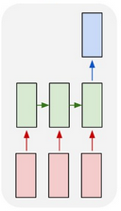
Recurrent Networks
Recurrent networks process sequences of arbitrary length; e.g.,
Sequence → sequence
Image → sequence
Sequence → class ID
Picture from http://karpathy.github.io/2015/05/21/rnn-effectiveness/

Slide 14
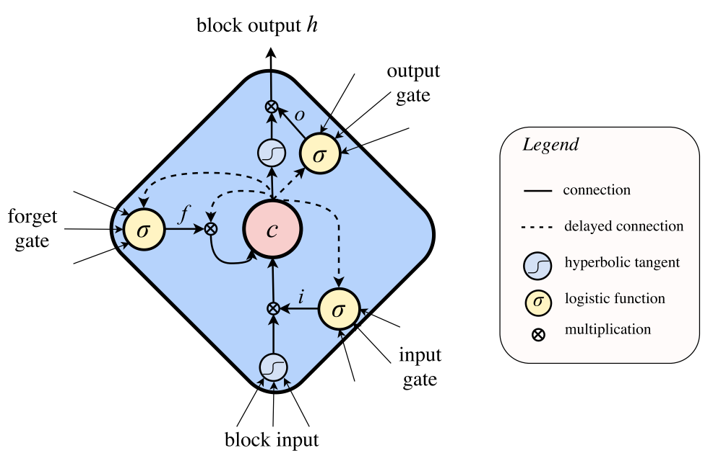
Recurrent Networks
Recurrent net consist of special nodes that remember past states.
Each node receives 2 inputs: the data and the previous state.
Keras implements SimpleRNN, LSTM and GRU layers.
Most popular recurrent node type is Long Short Term Memory (LSTM) node.
LSTM includes also gates,
which can turn on/off the
history and a few additional
inputs.
Picture from G. Parascandolo M.Sc. Thesis, 2015.
http://urn.fi/URN:NBN:fi:tty-201511241773

Slide 15
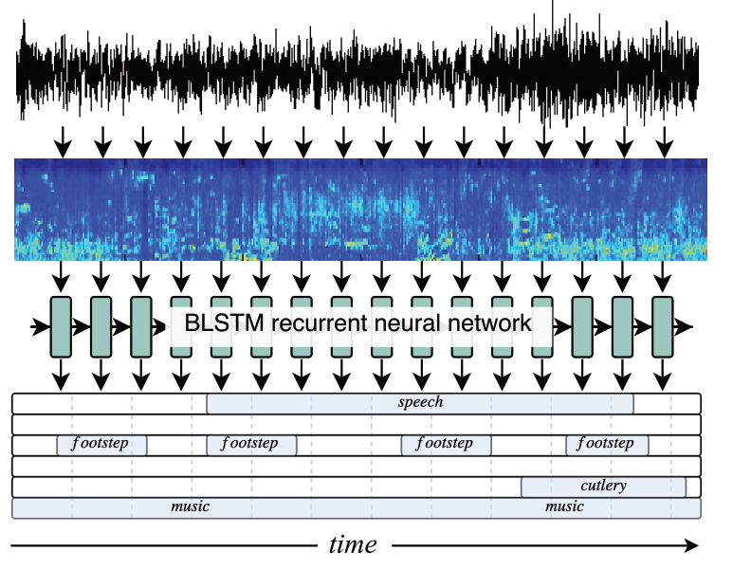
Recurrent Networks
An example of use is from our recent paper.
We detect acoustic events within 61 categories.
LSTM is particularly effective because it remembers the past events (or the context).
In this case we used a bidirectional LSTM, which remembers also
the future.
BLSTM gives slight improvement over LSTM.
Picture from Parascandolo et al., ICASSP 2016

Slide 16
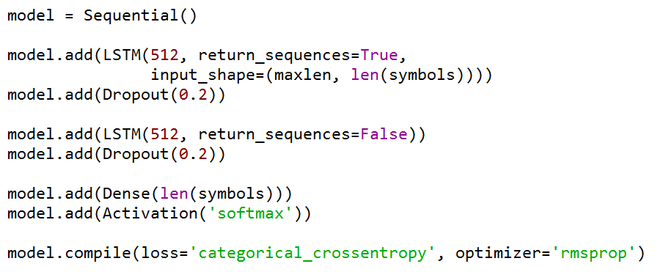
LSTM in Keras
LSTM layers can be added to the model like any other layer type.
This is an example for natural language modeling: Can the network predict next symbol from the previous ones?
Accuracy is
greatly improved
from N-Gram etc.

Slide 17
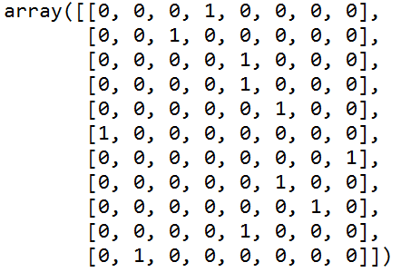
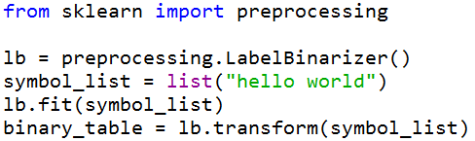
Text Modeling
The input to LSTM should be a sequence of vectors.
For text modeling, we represent the symbols as binary vectors.
_ d e h l o r w
Time

Slide 18

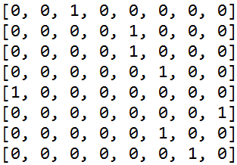
Text Modeling
The prediction target for the LSTM net is simply the input delayed by one step.
For example: we have shown the net these symbols: [’h’, ’e’, ’l’, ’l’, ’o’, ’_’, ’w’]
Then the network should predict ’o’.
H
E
L
L
O
_
W
E
L
L
O
_
W
O
LSTM
LSTM
LSTM
LSTM
LSTM
LSTM
LSTM

Slide 19
Text Modeling
Trained LSTM can be used as a text generator.
Show the first character, and set the predicted symbol as the next input.
Randomize among the top scoring symbols to avoid static loops.
H
E
L
L
O
_
W
LSTM
E
L
L
O
_
W
O
LSTM
LSTM
LSTM
LSTM
LSTM
LSTM

Slide 20
Many LSTM Layers
A straightforward extension of LSTM is to use it in multiple layers (typically less than 5).
Below is an example of two layered LSTM.
Note: Each blue block is exactly the same with, e.g., 512 LSTM nodes. So is each red block.
LSTM
LSTM
LSTM
LSTM
LSTM
LSTM
LSTM
LSTM
LSTM
LSTM
LSTM
LSTM
LSTM
LSTM

Slide 21
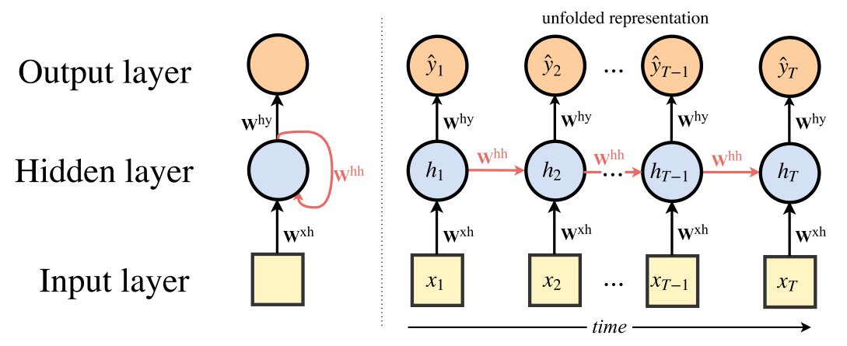
LSTM Training
LSTM net can be viewed as a very deep non-recurrent network.
The LSTM net can be unfolded in time over a sequence of time steps.
After unfolding, the normal gradient based learning rules apply.
Picture from G. Parascandolo M.Sc. Thesis, 2015.
http://urn.fi/URN:NBN:fi:tty-201511241773

Slide 22
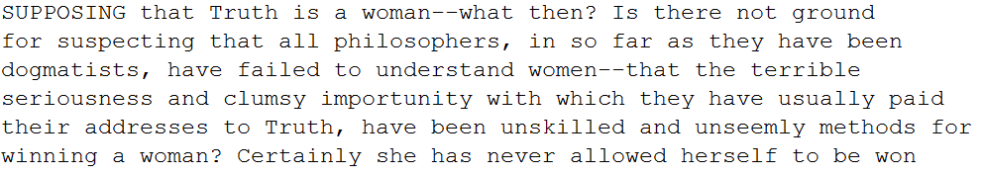
Text Modeling Experiment
Keras includes an example script: https://github.com/fchollet/keras/blob/master/examples/lstm_text_generation.py
Train a 2-layer LSTM (512 nodes each) by showing Nietzche texts.
A sequence of 600901 characters consisting of 59 symbols (uppercase, lowercase, special characters).
Sample of training data

Slide 23
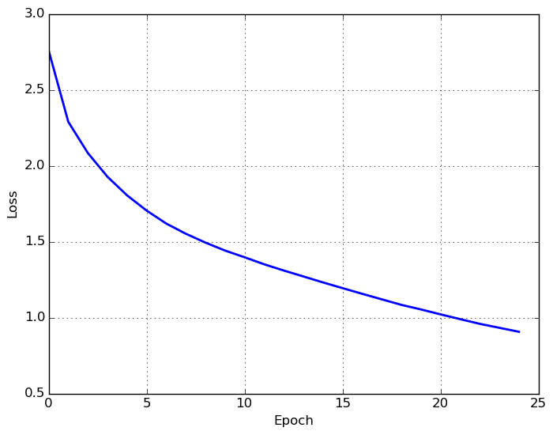
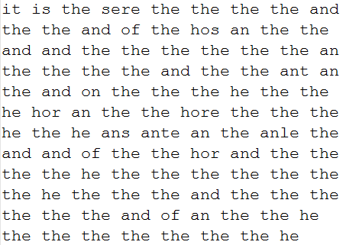
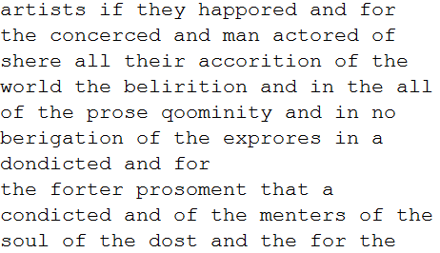
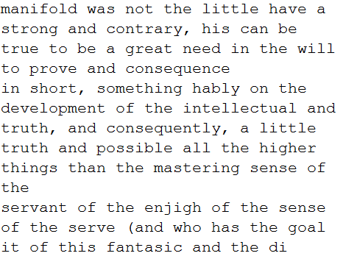
Text Modeling Experiment
The training runs for a few hours on a Nvidia high end GPU (Tesla K40m).
At start, the net knows only a few words, but picks up the vocabulary rather soon.
Epoch 1
Epoch 3
Epoch 25

Slide 24
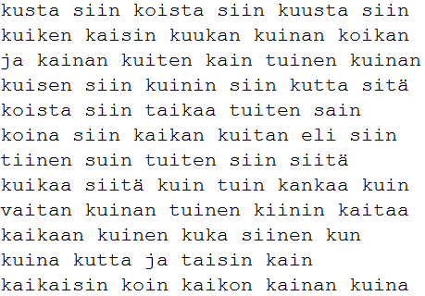
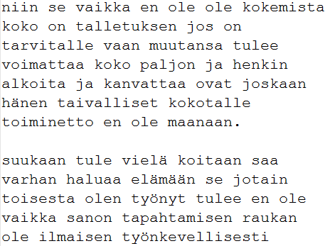
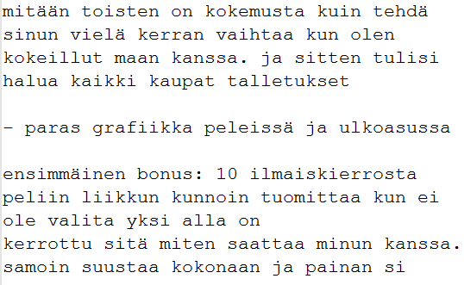
Text Modeling Experiment
Let’s do the same thing for Finnish text: All discussions from Suomi24 forum are released for public.
The message is nonsense, but syntax close to correct: A foreigner can not tell the difference.
Epoch 1
Epoch 4
Epoch 44

Slide 25
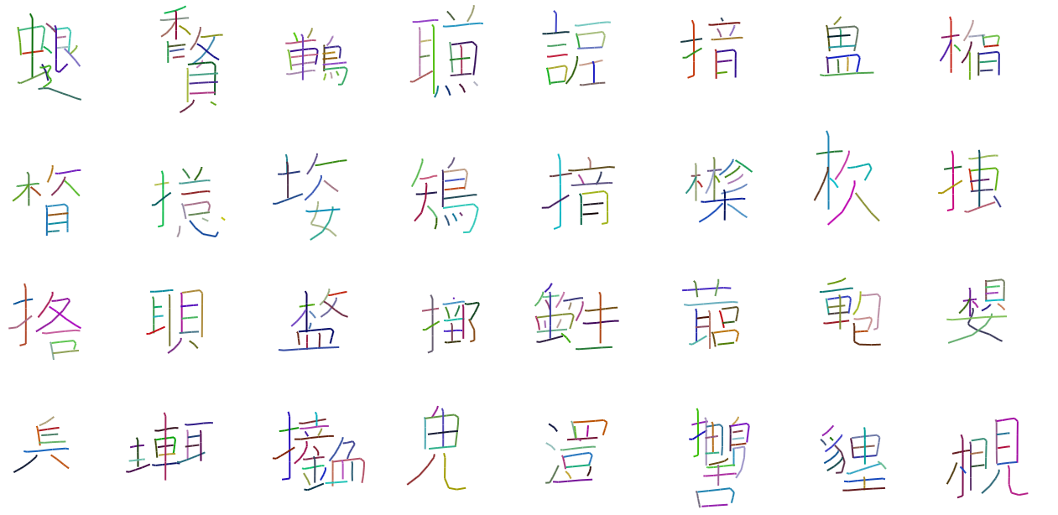
Fake Chinese Characters
http://tinyurl.com/no36azh

Slide 26
EXAMPLES

Slide 27

Age / Gender / Expression Recognition
TUT age estimation demo is an example of modern computer vision
System estimates the age in real time
Trained using a 500 K image database
Average error ±3 years

Slide 28

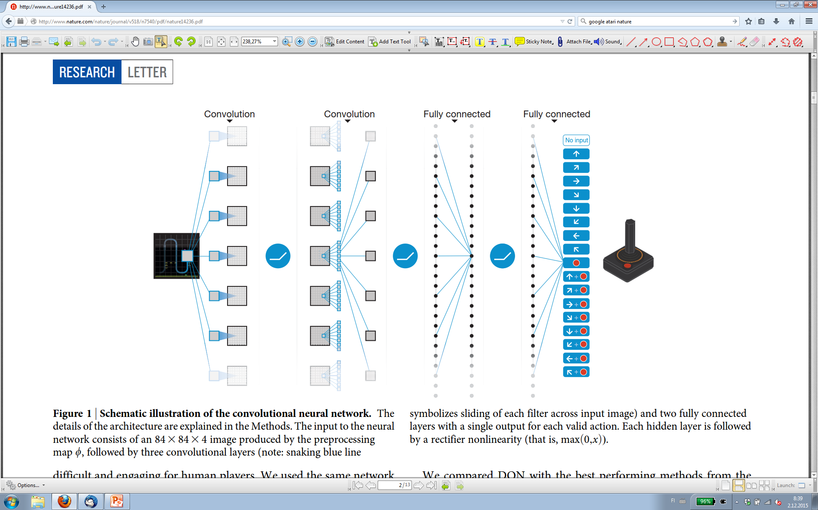
Deep Net Learns to Play
Mnih et al. (Google Deepmind, 2015) trained a network to play computer games
Better than human in many classic 1980’s games: Pinball, Pong, Space Invaders.

Slide 29
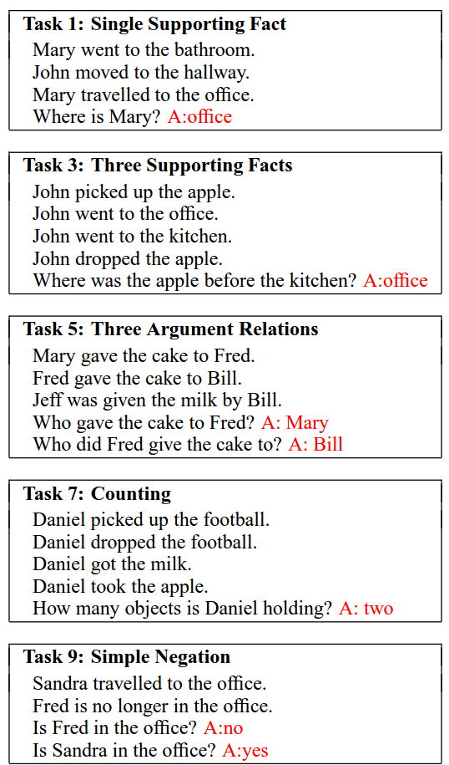
Computer and Logical Reasoning
Logical reasoning is considered as a humans-only skill
In this example, the computer was shown 1,000 question and answers
In all 10 categories, the computer answers with > 95 % accuracy (except Task 7: 85 %)
Weston et al., ”Towards AI-complete question answering”, ICLR2016.

Slide 30
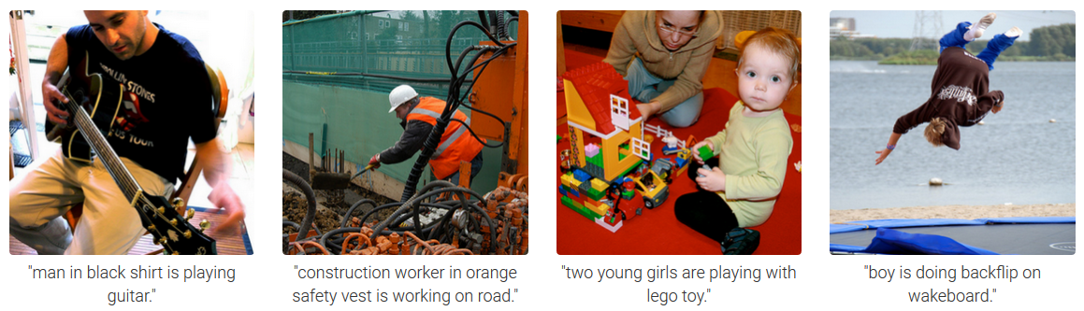
From Image to Text
Karpathy et al., ”Deep Visual-semantic Alignments for Generating Image Descriptions,” CVPR 2015, June 2015.

Slide 31
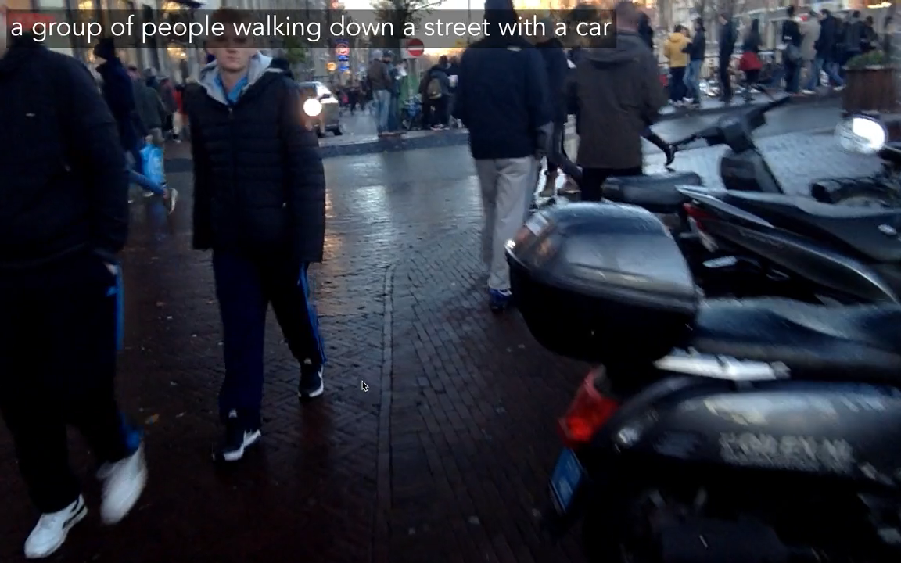
From Video to Text
https://www.youtube.com/watch?v=8BFzu9m52sc

Slide 32
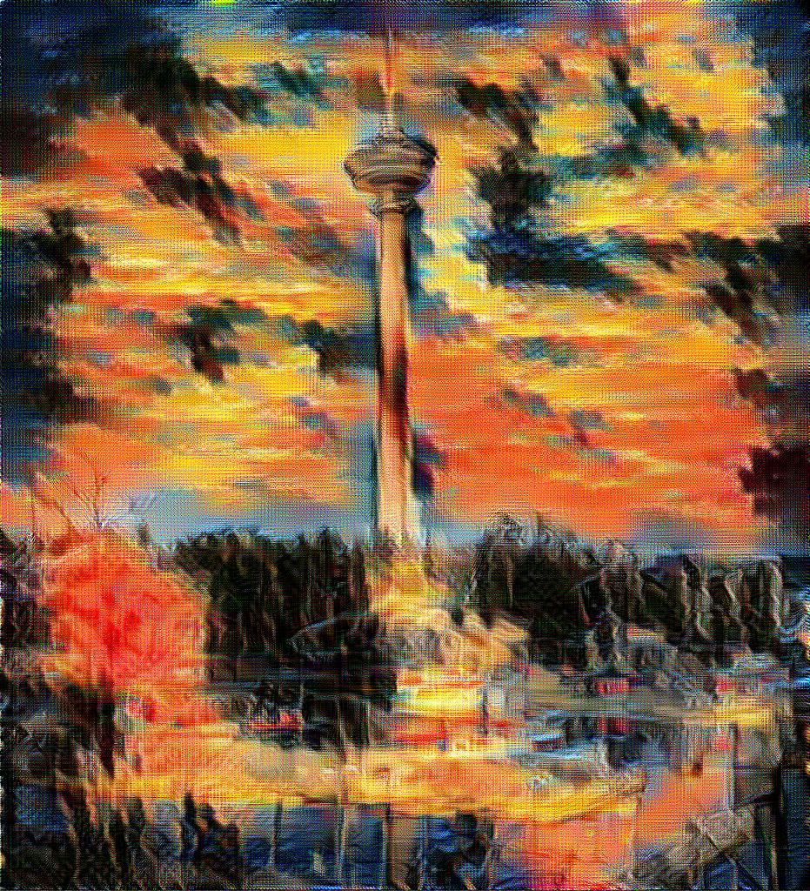
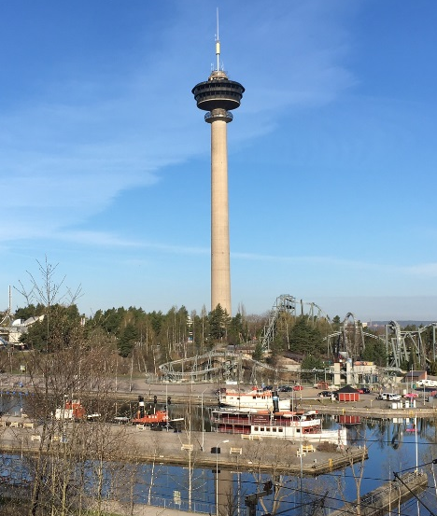
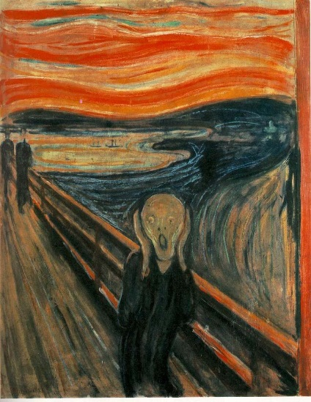
Artistic Style Transfer
+
=
Check out Prisma App

Slide 33

Pretraining
With small data, people often initialize the net with a pretrained network.
This may be one of the imagenet winners; VGG16, ResNet, …
See keras.applications for some of these.
VGG16 network source: https://www.cs.toronto.edu/~frossard/post/vgg16/

Slide 34
To Conclude…
During the last ten years, the landscape of artificial intelligence has reached a new level of maturity:
Infrastructure has been built to allow low cost access to high-performance computing.
Publicity of the results has become a standard model in dissemination of the research results.
Resources have increased: Companies are extremely active in AI research, and aggressively headhunting for the best talents in the field.
Methods have been improved and computers are increasingly able to solve human-like tasks.

